Slide 1
Webinar
Advice on: NZ ETS unit limits and price control settings for 2027–2031
12 May 2026
Jo Hendy, Chief Executive
Sam Holmes, Project Director
Rachael Young, Principal Analyst

Slide 2
Today’s session
Welcome
Our NZ ETS settings advice (25 minutes)
    Context
    Unit limits
    Price controls
    What happens next
Q&A (30 minutes)
Close

Slide 3
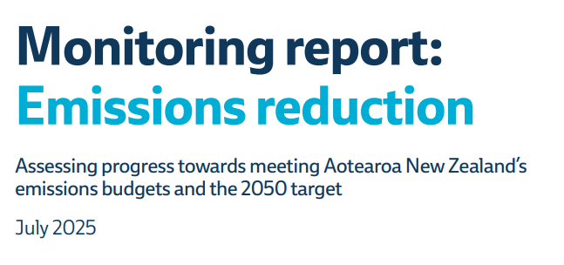

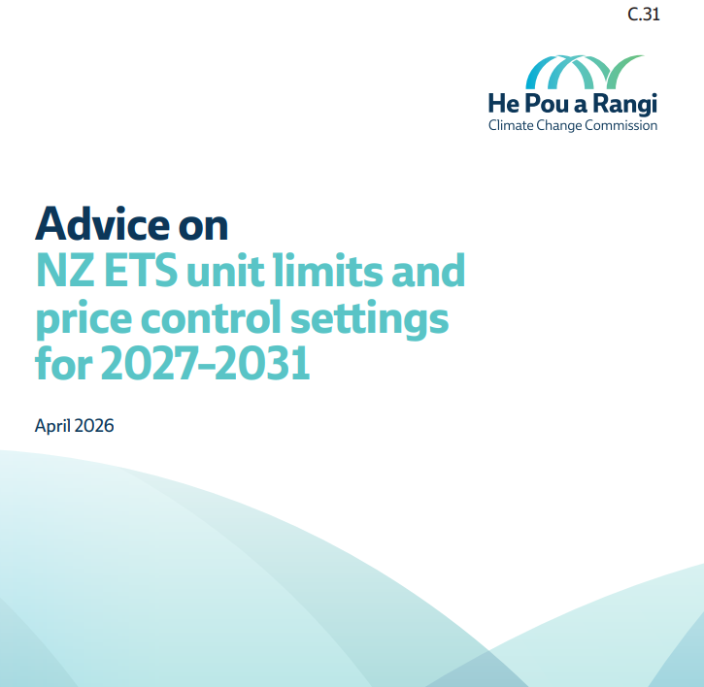
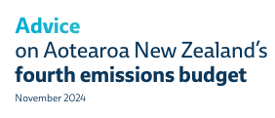
Our focus for this webinar
This NZ ETS settings advice
Narrow scope – focused on aligning unit auction settings with NZ’s emissions targets.
About operating the NZ ETS as well as possible – given its current structure and current Government policy.
Our other emissions reduction mahi
Addresses bigger picture climate policy issues – eg, the level of targets, how to achieve them, and NZ ETS overall role and structure.
Monitors progress
July 2026
March
2027
Updates coming

Slide 4
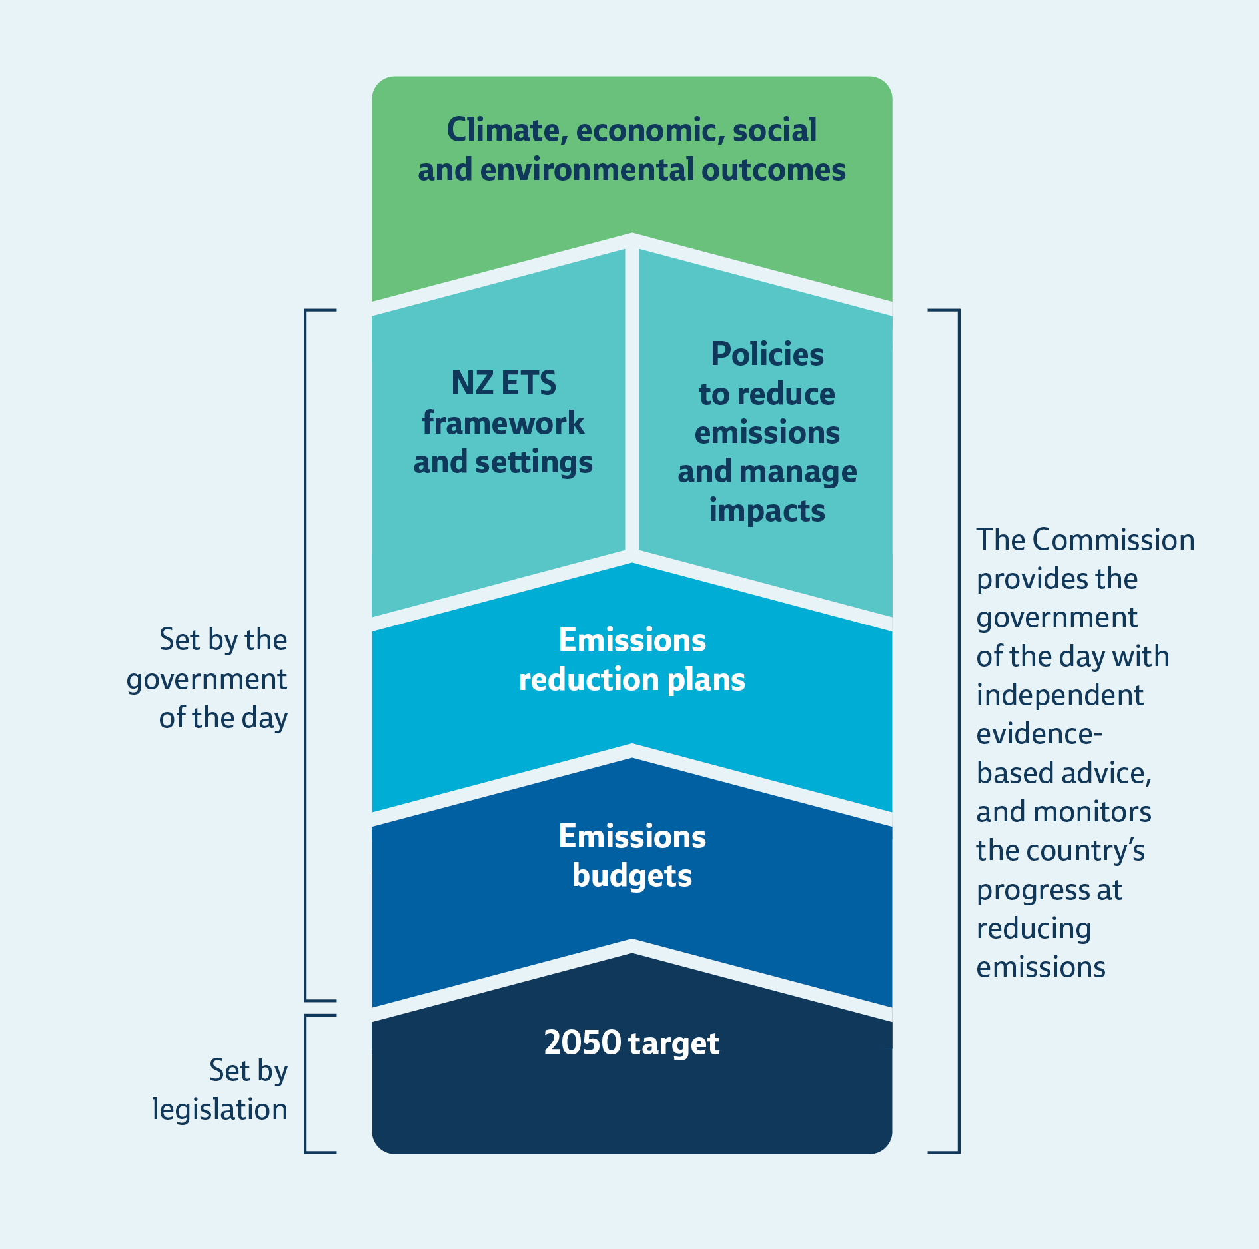
Framework in the Climate Change Response Act (2002)
NZ ETS is a tool that acts as a messenger between emissions reduction targets and the economy.
Emissions budgets are the key targets guiding domestic reduction efforts.
Emissions budgets and 2050 target are the climate targets that guide our advice on
NZ ETS settings.

Slide 5
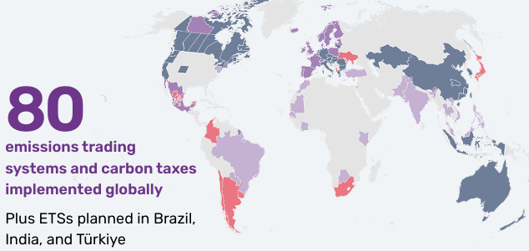
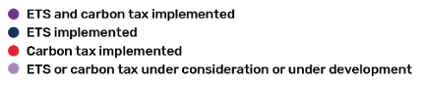
Wider context
Emissions pricing is effective and widely used – globally there are 37 ETSs + 20 more in development, plus other carbon levies
Purpose: encourage the shift to low-emissions options through gradual and steady price rise over time
Source: World Bank. 2025. State and Trends of Carbon Pricing 2025

Slide 6
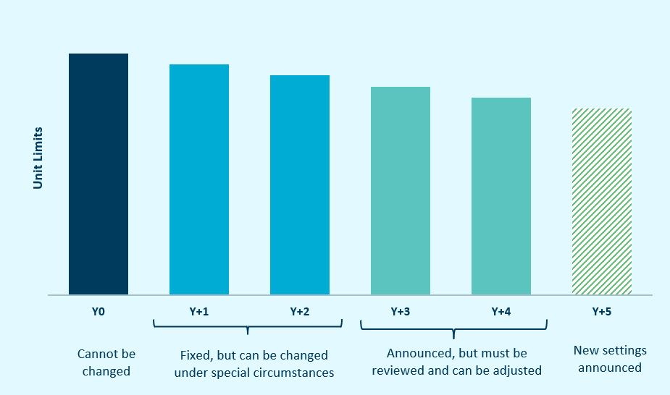
Context: Approach to managing NZ ETS settings
The five-year rolling process for auction unit limits and price control settings
NZ ETS settings must accord with emissions budgets and the 2050 target.
Annual review of NZ ETS settings allows adaptive management.

Slide 7
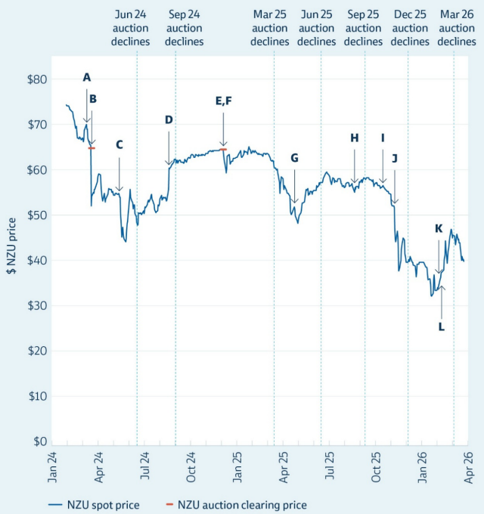
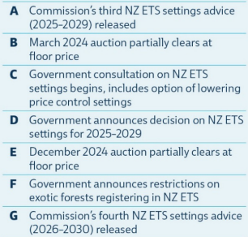
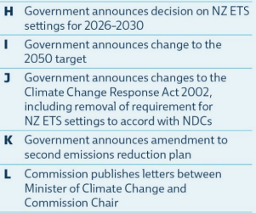
NZU
spot price
Source:
Carbon News NZU Carbon Price Index

Slide 8
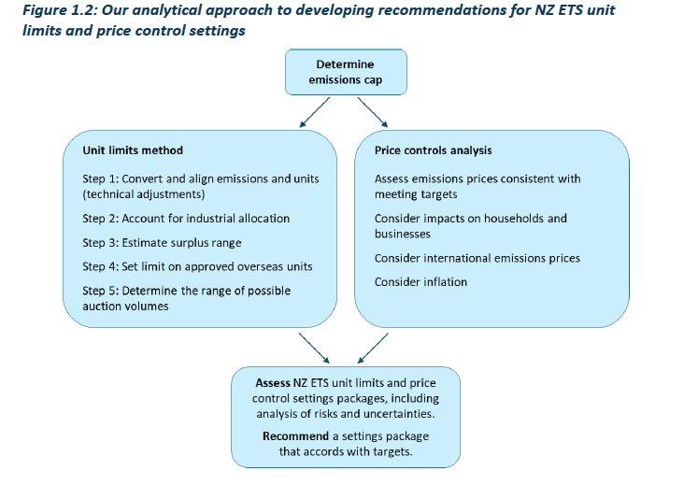
Updated analytical approach
We must recommend unit limit and price control settings that accord with emissions budgets and the 2050 target.
In late 2025, legislative change removed the requirement to accord with nationally determined contributions (NDCs).
To reflect this, we have updated our method for developing our advice.

Slide 9
NZ ETS emissions cap
Latest emissions projections mean the Government’s August 2025 emissions caps no longer accord with emissions budgets – due to higher projected agricultural emissions.
This is most significant for the cap over the third emissions budget period.
We looked at even lower emissions caps but considered these were not enabled by the Government’s emissions reduction plan.
 | Cap option (MtCO₂e) | Net cap | Sum with non-NZ ETS emissions | Difference to budget | Further effort for NZ ETS sectors
Second emissions budget (2026 – 2030, 305 Mt) | 1.Status quo | 89.4 | 308.9 | 3.9 | 7.5
 | 2. CCC revised cap | 81.9 | 301.4 | –3.6 | 0
Third emissions budget (2031 – 2035, 240 Mt) | 1. Status quo | 40.7 | 251.8 | 11.8 | 3.0
 | 2. CCC revised cap | 28.9 | 240.0 | 0 | –8.7

Slide 10
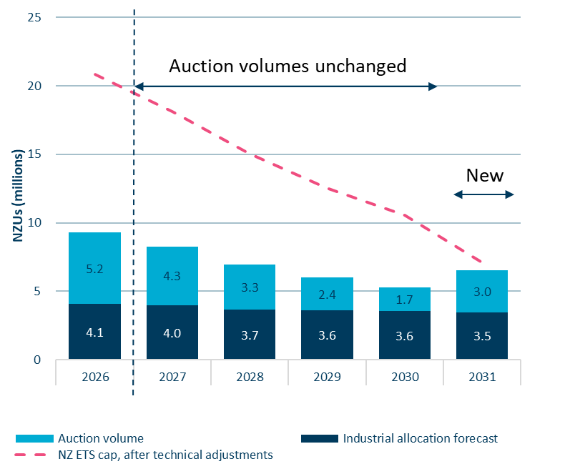
Unit limits (1): Our advice
Maintain current NZU auction volumes through to 2030.
Set 2031 auction volumes on the basis that the surplus units in the market have depleted.
Prepare for a risk of a unit shortfall over 2028-2030.

Slide 11
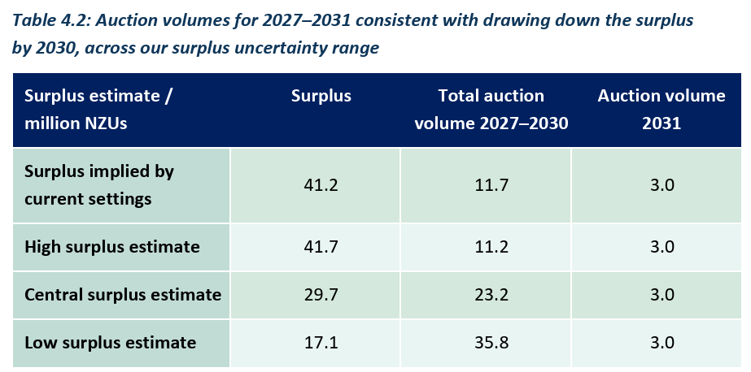
Unit limits (2): Surplus and auction volume ranges
Estimated surplus range
Estimated at 17 to 42 million units, with a central estimate of 30 million units.
Significant reduction on last year’s 28 to 68 million estimated range, with a central estimate of 50 million units.
The reduction is due to:
  12.5 million unit expected surplus drawdown
  6 million units not selling at 2025 auctions
  1.9 million units from updated data and assumptions
Range of possible auction volumes

Slide 12
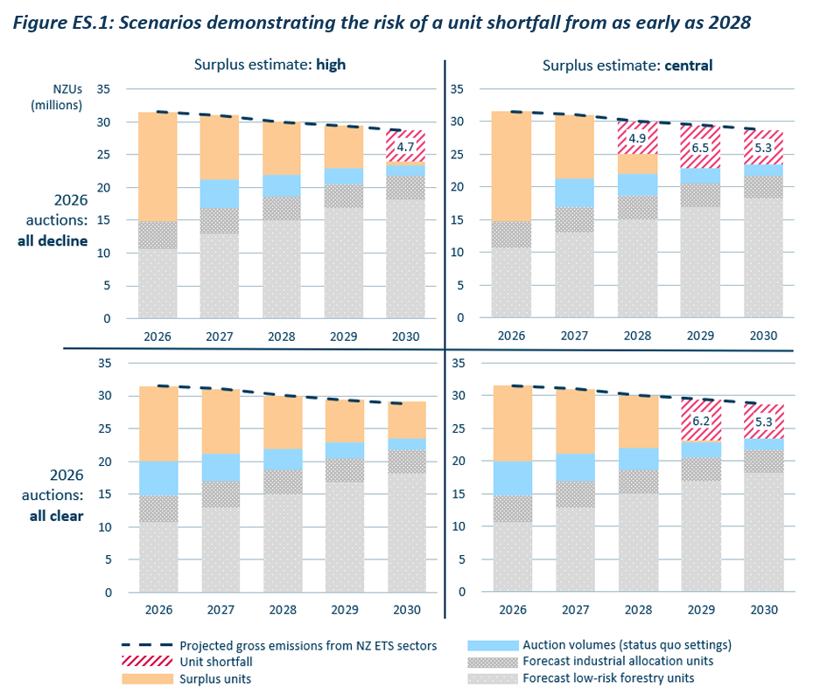
Unit limits (3): Risk of a unit shortfall
We assess that the market could be undersupplied as early as 2028.
A unit shortfall could cause rapid increases and volatility in NZU prices, leading to:
  disruptive economic impacts (e.g. reduced production, factory closures and job losses).
  pressure on the Government to intervene in the market
  delay to investments to reduce emissions.
We advise the Government to make a plan and signal how it will mitigate this risk.

Slide 13
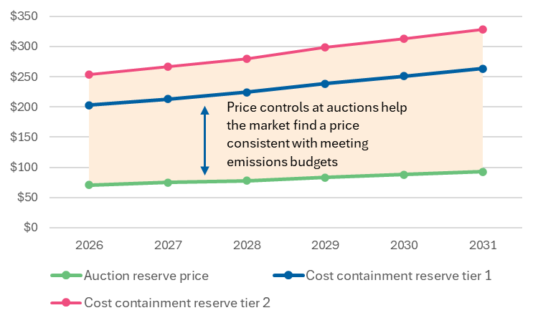
Price controls (1): Fit-for-purpose with inflation adjustments
The ARP and CCR trigger prices should remain at current levels, adjusted only for inflation.
The current settings are consistent with the Government’s emissions reduction targets.
This is consistent with our findings last year.

Slide 14
Price controls (2): Increases may be needed in future
In 2025, we advised that both the ARP and CCR may need to be increased in future - depending on the extent and cost of gross emissions reductions needed to meet the third emissions budget.
Both these factors are very uncertain and will be affected by trends in fossil gas prices, EV uptake and afforestation.
These uncertainties have not sufficiently resolved over the past year to justify any increase in the price control settings at this stage.
We will monitor developments and address any necessary changes in future NZ ETS settings advice.

Slide 15
Price controls (3): Why not increase/decrease ARP
We have considered whether raising the ARP would be beneficial in the short term. However, it is unclear that increasing the ARP would have any material effect on emissions in the short term.
We see no case for lowering the ARP, now or in the future. Reducing the ARP would increase the risk of not meeting emissions reduction targets.

Slide 16
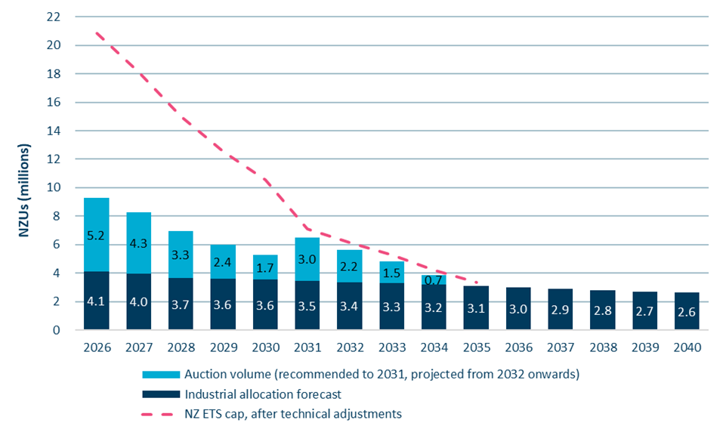
Challenges for the future operation of the NZ ETS
Forecast industrial allocation and auction volumes to 2040
The NZ ETS will soon no longer be able to drive further net emissions reductions.
This reinforces the need for the Government to consider the role of the NZ ETS in meeting emissions reduction targets beyond this decade, and ensure it is fit for purpose to play its part.

Slide 17
What happens next for our emissions reduction mahi
Mid-2026
MfE to consult on NZ ETS settings.
15 Jul 2026
Commission’s next
emissions reduction monitoring report
Early 2027
Commission’s next
NZ ETS settings advice, for 2028–2032.
30 Sep 2026
Govt must finalise NZ ETS settings for 2027–2031.
31 Mar 2027
CCC updated advice on second, third and fourth emissions budgets
31 Dec 2027
Govt must set fourth emissions budget
NZ ETS Settings
Other mahi

Slide 18
Our adaptation mahi
National climate change risk assessment
climatecommission.govt.nz/2026-national-climate-change-risk-assessment
  Zui – for iwi/Māori audiences
  Tuesday 19 May
  Webinar – general overview
  Wednesday 20 May
  Register via climatecommission.govt.nz/events
  National Adaptation Plan progress assessment
  Expected release by mid-August

Slide 19

Pātai?
Want to get in touch?
hello@climatecommission.govt.nz

