Slide 1
Webinar
National climate change risk assessment
20 May 2026
Karen Lavin, General Manager, Evidence and Advice
Holly Walker, Project Director

Slide 2
Why this matters
People are facing more and more disruption from climate-related events.
Climate change is reshaping the hazards we’re facing as a country.
This is not business-as-usual hazard management.
The assessment prioritises where focused and coordinated action can make the biggest difference.

Slide 3

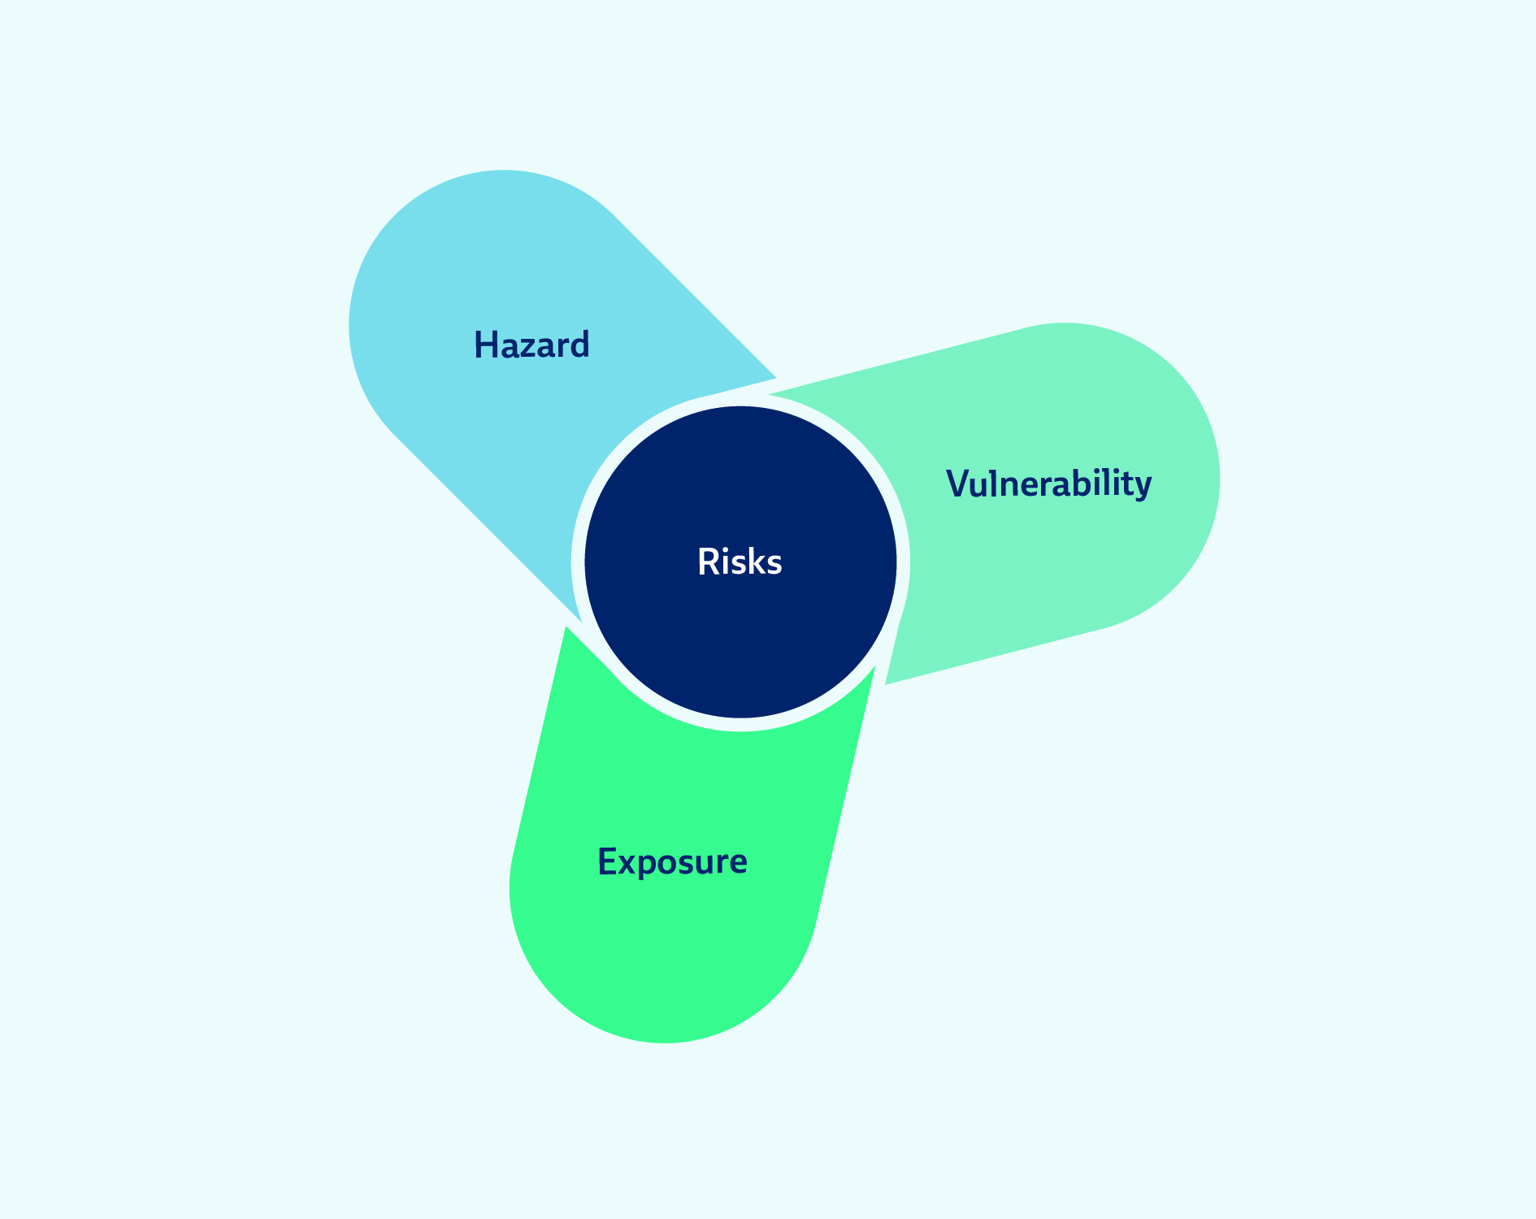
Purpose
Assess the risks
Identify the most significant

Slide 4

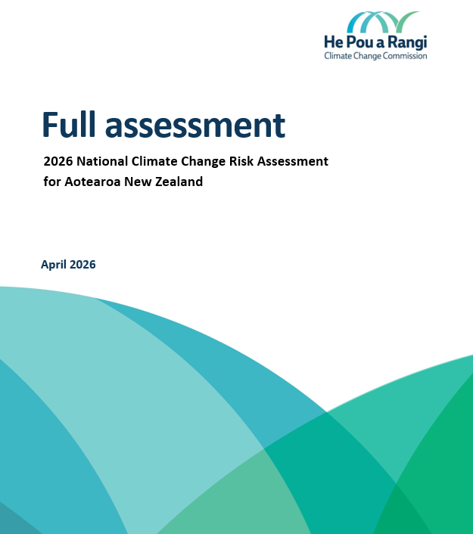
What the assessment provides
A comprehensive scan of climate risks at a national level
A view of what is underway to address them
Descriptions of the ten most significant risk areas
Detailed analysis and scoring for all 37 risks
A summary of projected climate change and related hazards

Slide 5
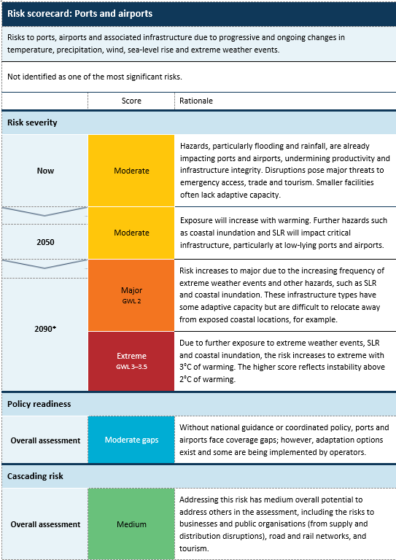
How we assessed the risks
Severity
Scale: Minor > Extreme
Time: Now, 2050, 2090 under two scenarios
Policy readiness
Scale: No significant gaps > Insufficient
Cascading risk
Scale: Low > Very high
A measure of potential to address other risks
Significance

Slide 6
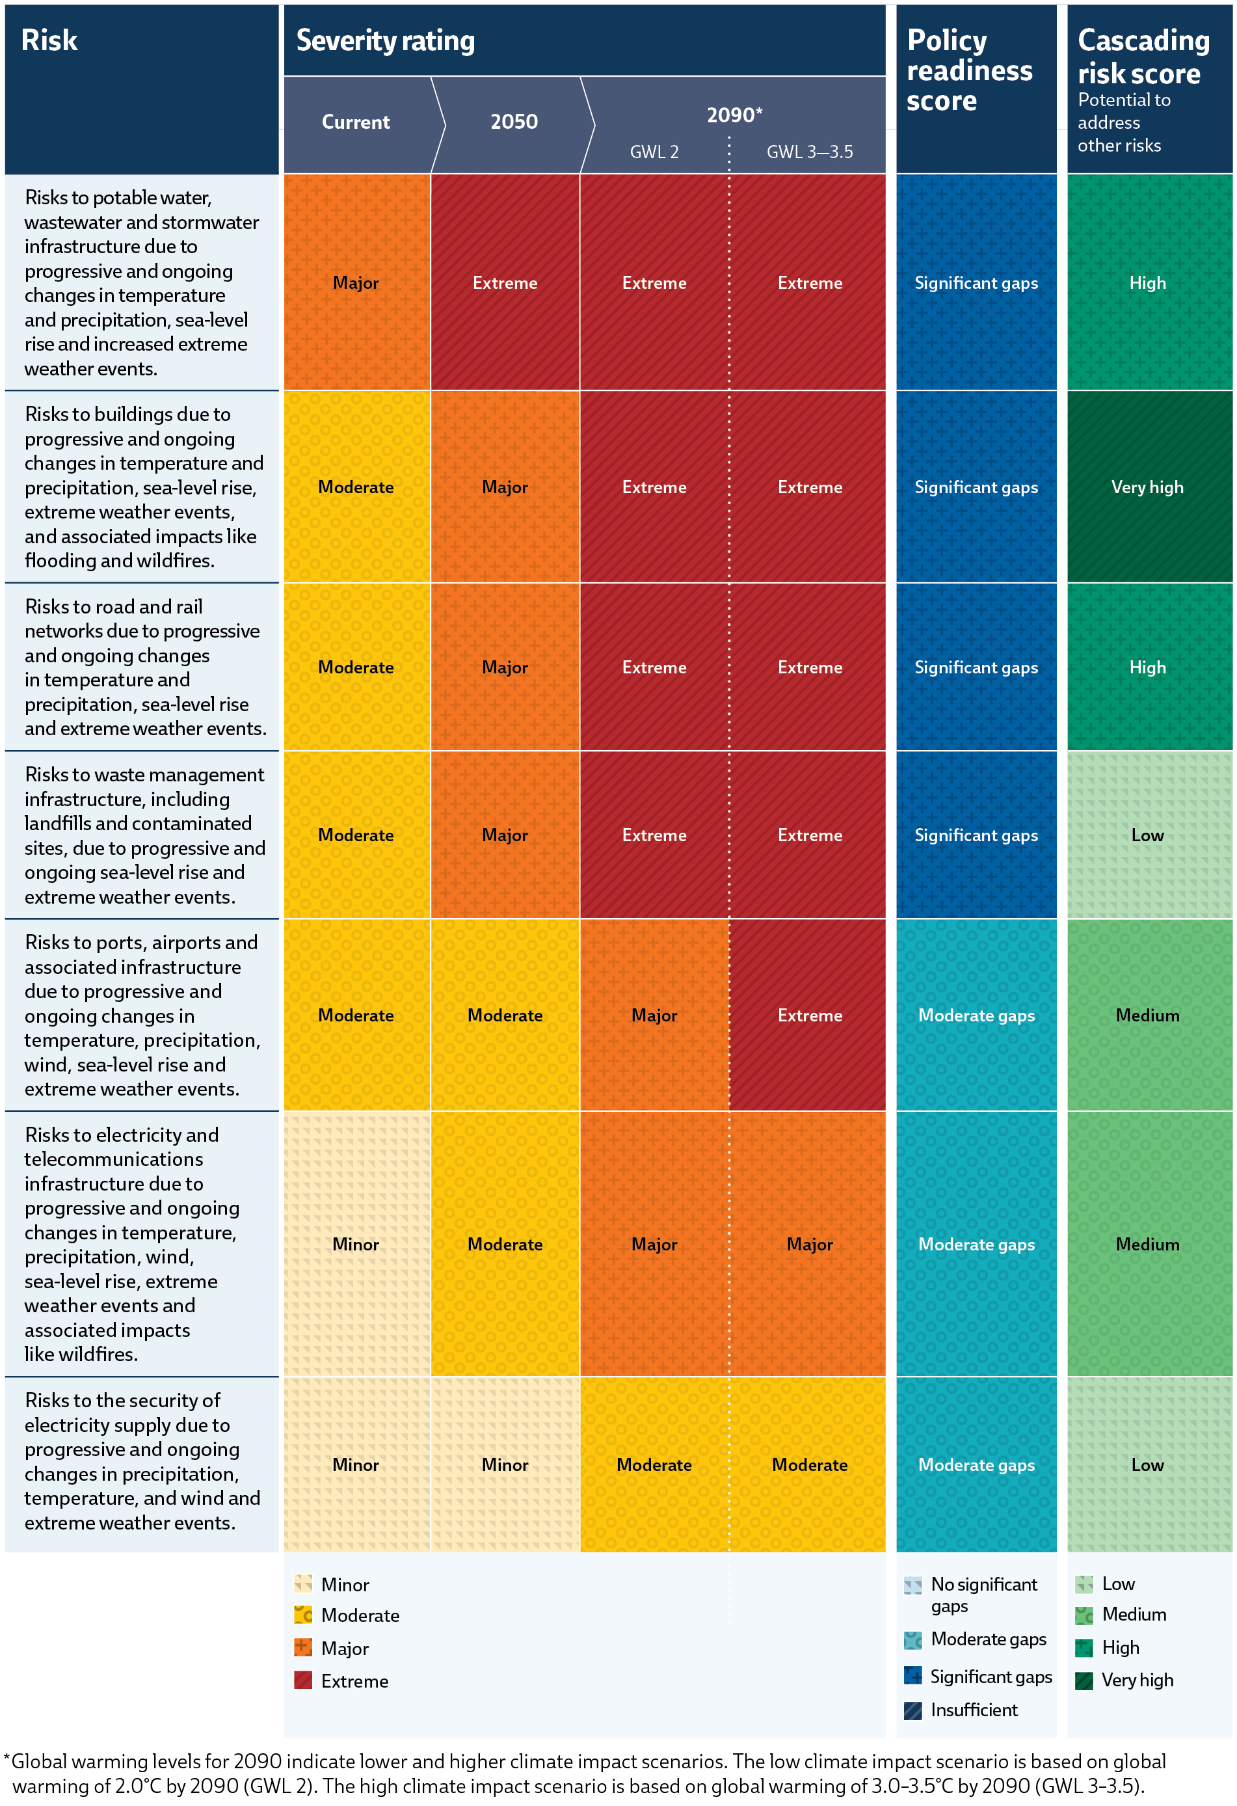
Examples of a risk and domain scorecard

Slide 7
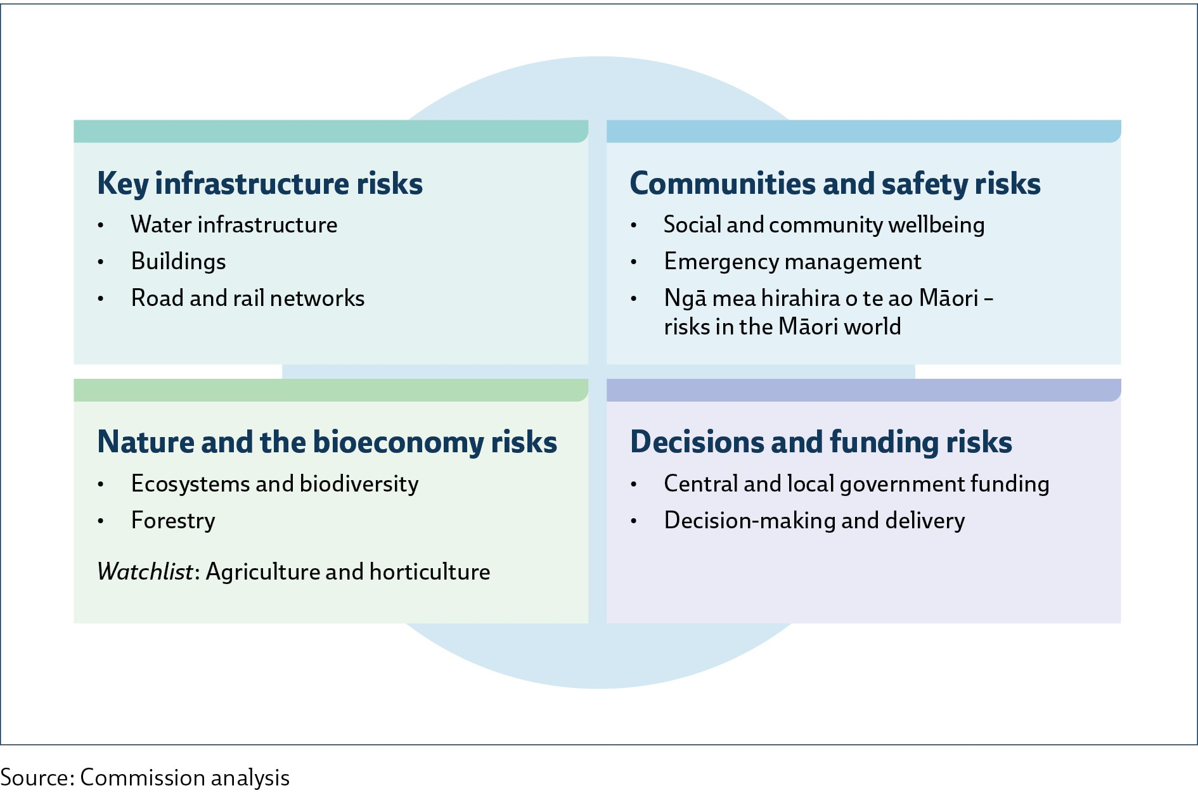
The ten most significant climate risks

Slide 8





Key infrastructure; Communities and safety
Risks to water infrastructure
Risks to buildings
Risks to road and rail networks
Key infrastructure
Risks to social and community wellbeing
Risks to emergency management
Ngā mea hirahira o te ao Māori – risks in the Māori world
Communities and safety

Slide 9


Nature and the bioeconomy; Decisions and funding
Risks to ecosystems and biodiversity
Risks to forestry
Ones to watch – agriculture and horticulture
Nature and the bioeconomy
Risks to central and local government funding
Risks to decision-making and delivery
Decisions and funding

Slide 10
Navigating the future
We know enough to know what to expect, and we know enough to act.
The risk assessment is a tool to help prioritise actions and resources to put the country in a good position. It is not a prediction.
Improving the evidence base = even greater precision in future assessments.

Slide 11
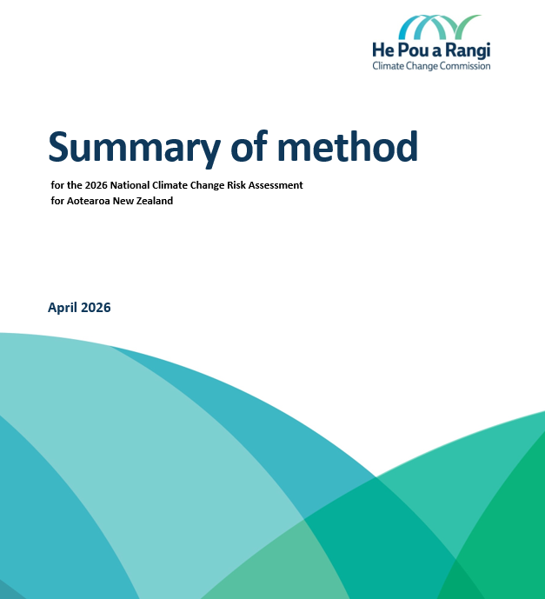

Supporting material and evidence
Summary of method
Independent analysis of Ngā mea hirahira o te ao Māori
Other supplementary material and commissioned research

Slide 12
Key takeaways
The assessment sets out the priorities for decision-makers, businesses and communities.
It shows where planning and investment can make the biggest difference.
Acting sooner rather than later will minimise the cost.
Reducing global emissions is also needed to slow climate change

Slide 13
Questions?
For more information: nccra@climatecommission.govt.nz

