Slide 1
Emissions Reduction Monitoring 2025
July 2025
Jo Hendy, Chief Executive
Rob Carr, Project Director

Slide 2
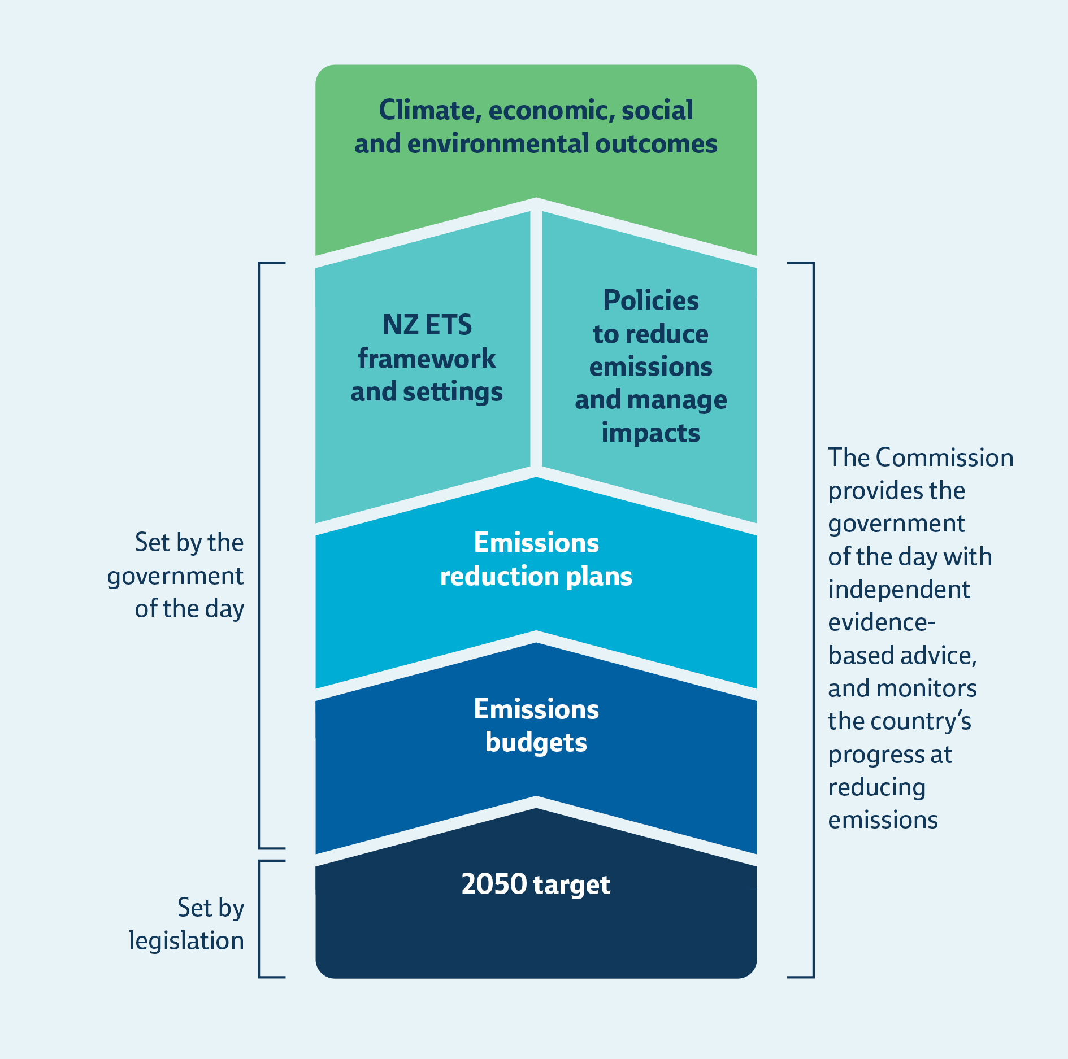
Commission’s role
We provide independent, evidence-based advice to government ​
We monitor the country’s progress towards our climate change goals​
Our research and analysis provides insights into progress, challenges, risks and opportunities
Annual emissions monitoring builds a picture over time

Slide 3
What we do and why
Purpose Requirements
What’s measured, gets managed
Course-correction
Accountability
Emissions and removals
Projections
Assessment of adequacy, progress, and new opportunities

Slide 4
Approach to report
We have used the same approach and framework as
last year.
Since our 2024 report, the Government has finalised
the second emissions reduction plan. This means that the factors that we assessed against have changed.
Our review covers latest available data, and government policy and action for the 12 months up to 1 April 2025.
This year, there are summaries for different audiences.

Slide 5
How it all fits
Our work Purpose
Emissions budgets and 2050 target
NZ ETS
Annual emissions monitoring report tracks
To advise the Government whether budgets and target should or shouldn't be changed
Align unit volumes in the scheme with the Government’s plan to meet current budgets and targets
Tracks progress against current emissions budgets and 2050 target, and assesses whether the Government’s emissions reduction plan is adequate

Slide 6
Our findings
The country is making progress on reducing greenhouse gas emissions
Emissions are on track for the first budget, but will need more work – urgently – to set up for future reductions
Action across a wide range of sectors can strengthen the country’s resilience to changing global conditions

Slide 7
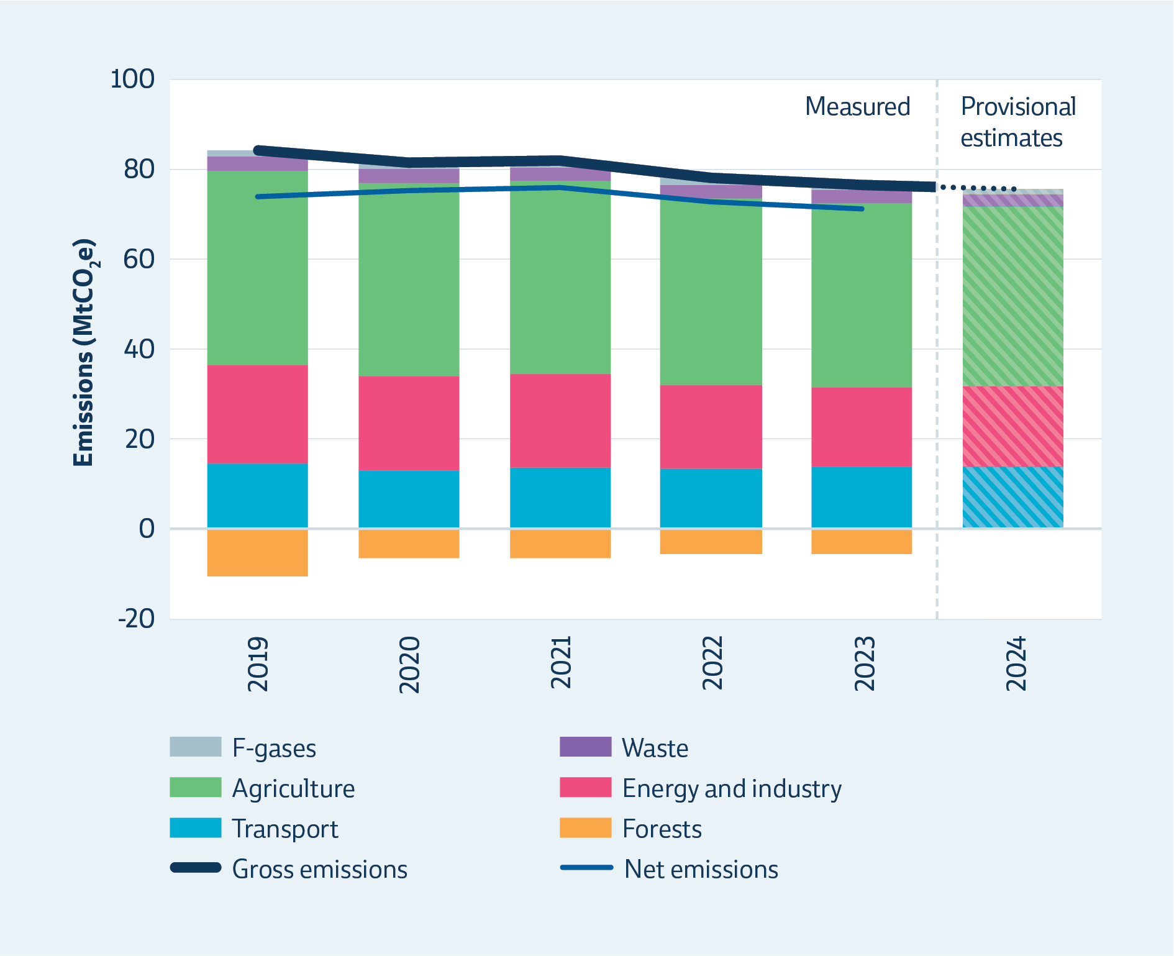
Emissions
Gross emissions have declined steadily since 2019
Both net and gross emissions reduced by 2% between 2022 and 2023

Slide 8
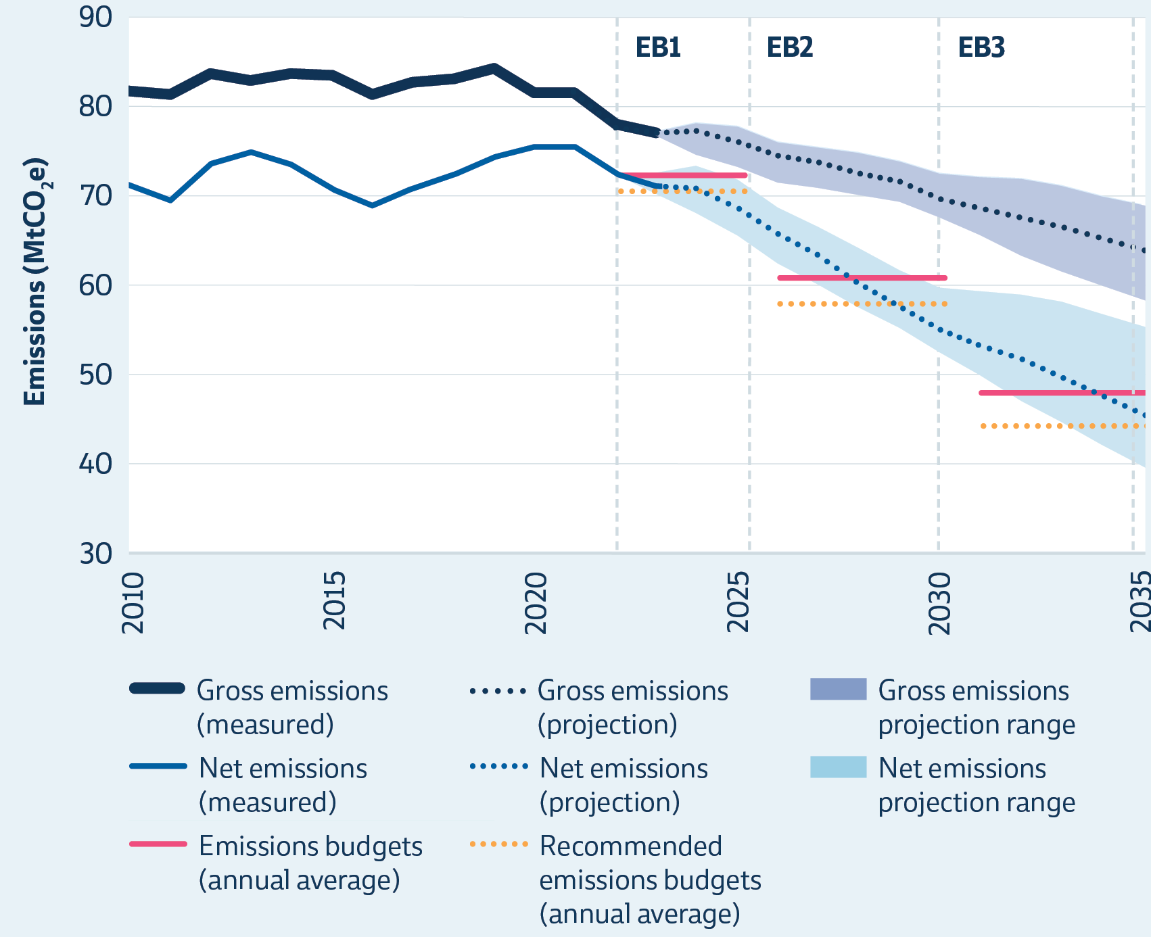
Projections
Government projections are consistent with the first and second budgets being met
However, greater reductions would be needed to meet the current third emissions budget or if budgets are revised

Slide 9
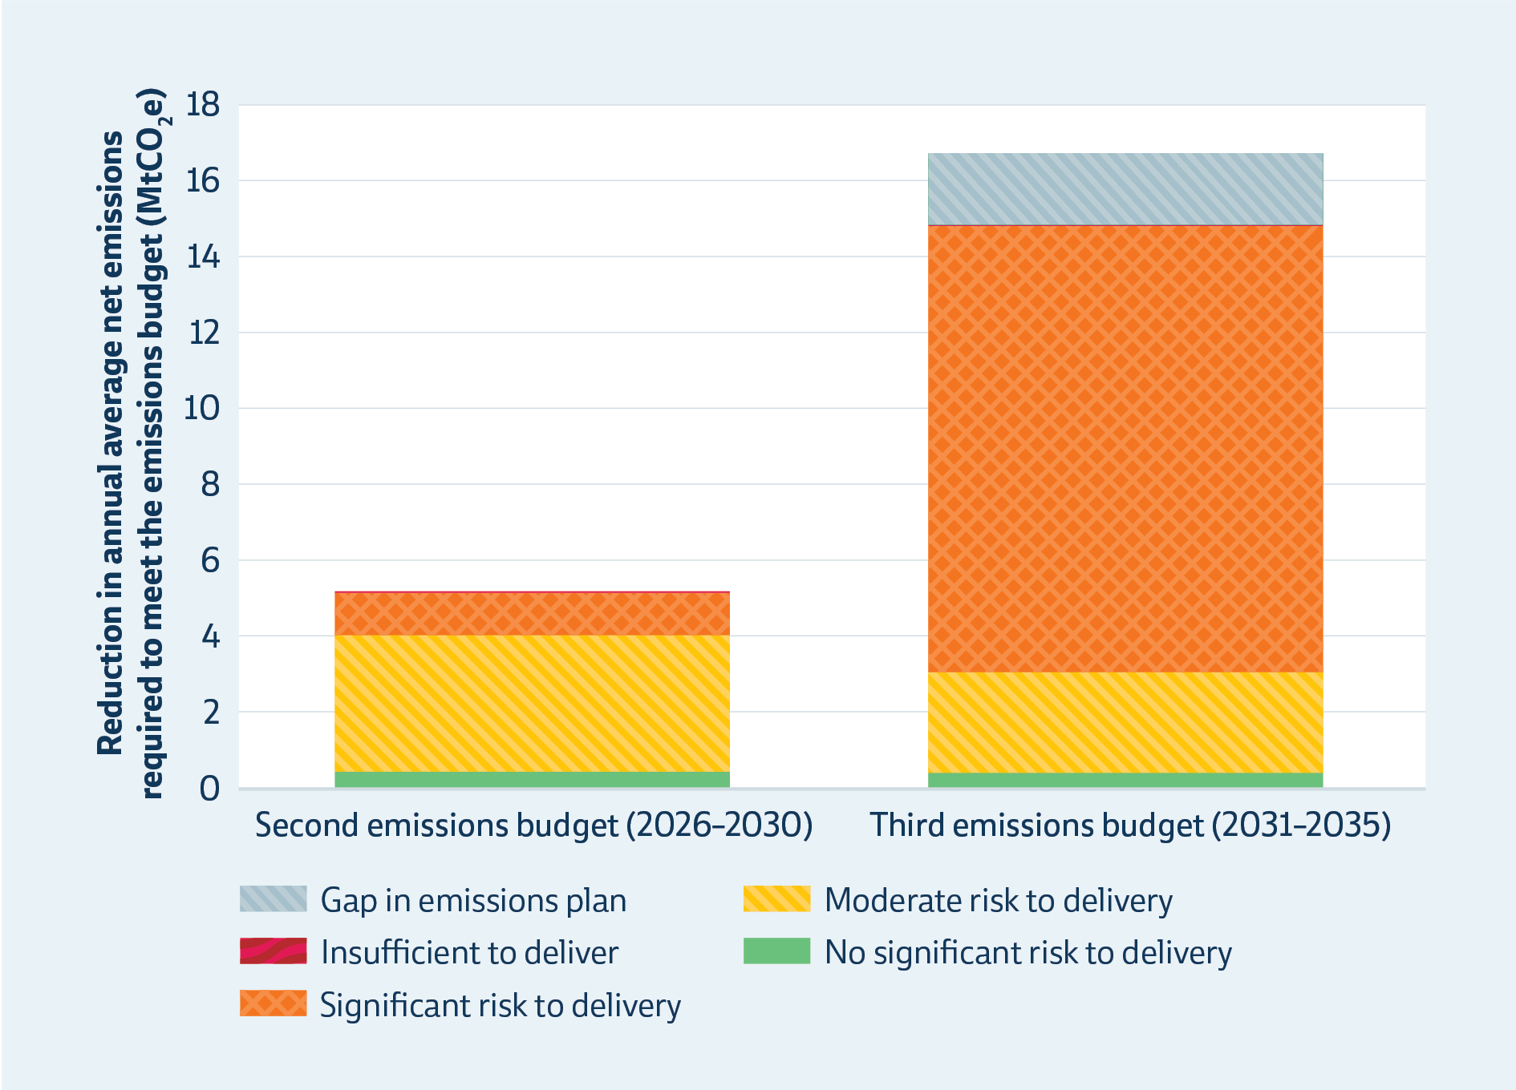
Risks
First emissions budget: electricity generation, forests, inventory change
Second and third budgets: energy and industry, forests
Buffers are critical

Slide 10
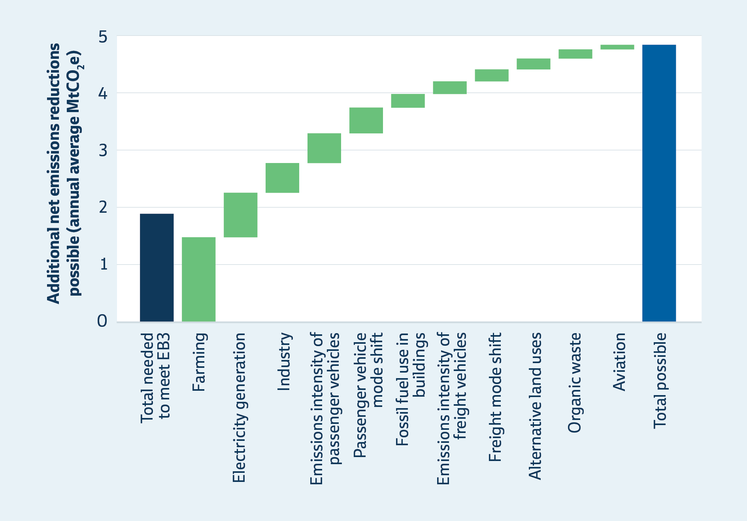
Opportunities
Opportunities in third budget period
Supporting agricultural producers to take up new tech and farm practices will maximise competitive advantage and realise benefits of Government’s investments
Falling prices for solar, EVs, and batteries could accelerate the shift to an affordable and reliable low-emissions energy system
Supporting private sector and Māori-led action can deliver additional reductions and wider benefits without significant fiscal cost

Slide 11
Recommendation
We recommend the Government acts ahead of the third emissions reduction plan, to reduce risk for the second emissions budget and get on track for the third budget and 2050 target, by:
strengthening the New Zealand Emissions Trading Scheme (NZ ETS) to ensure it can be effective as a key policy tool for reducing emissions and
implementing additional targeted policies to complement the NZ ETS, focused on renewable energy, transport and agriculture.

Slide 12
What's next?
Government has 3 months to respond.
Find out more on our website:
One-page A3 | Summarises key findings, facts and figures
Summaries | At a glance, sector & whakahekenga rehukino summaries
Main report | Sets out the Commission’s findings in full
Technical Annex + data | Technical annex sets out more detail on methods and data & we’ve released data we’ve relied on

Slide 13
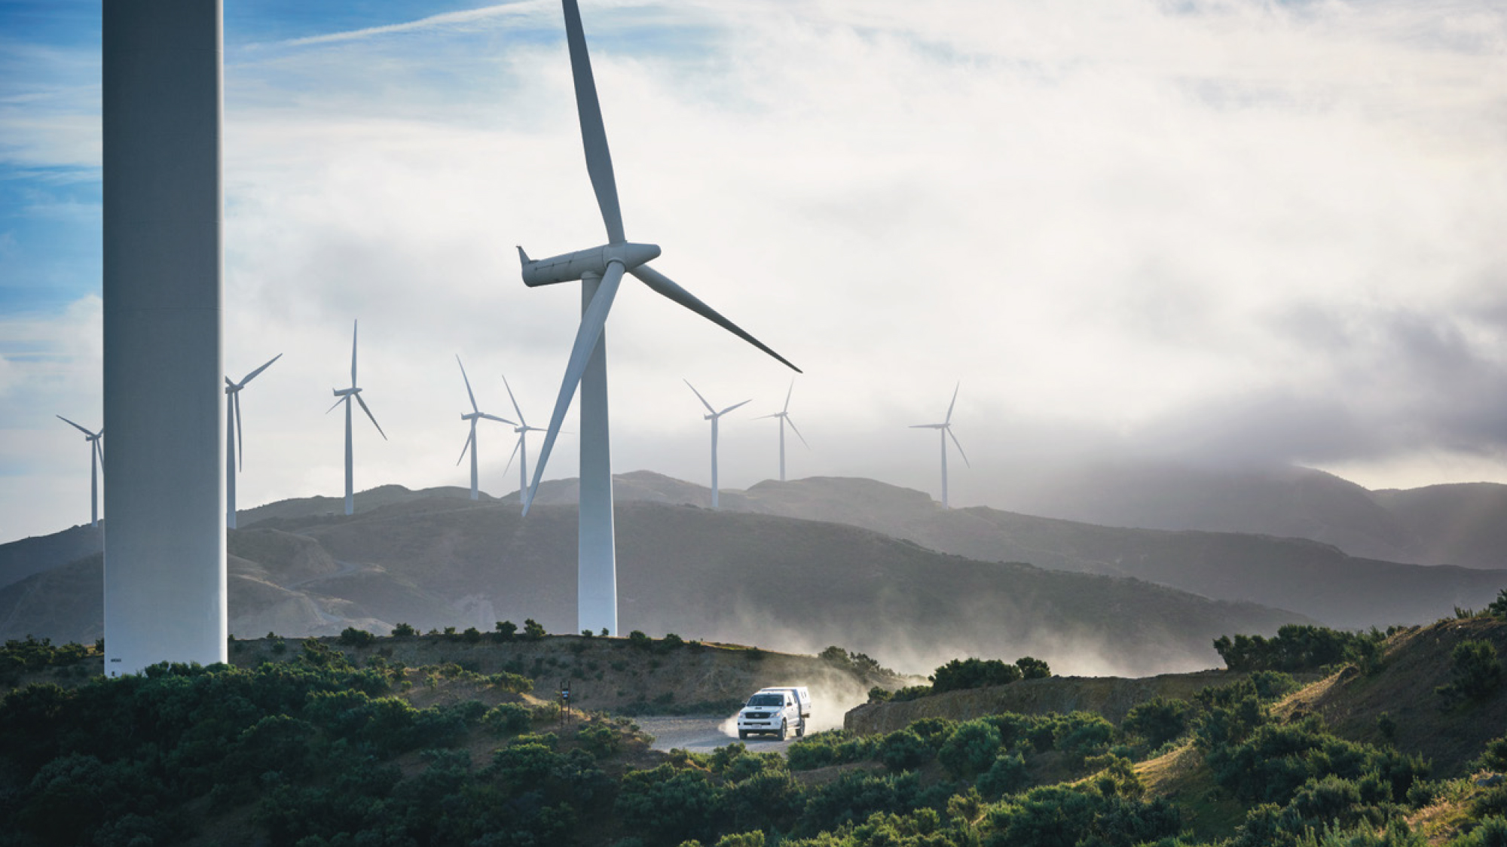
Pātai?
Want to get in touch?
hello@climatecommission.govt.nz

