Slide 1
Advice on
NZ ETS unit limits and price control settings for 2026–2030
8 May 2025
Jo Hendy, Chief Executive
Eva Murray, Principal Analyst
Matt Smith, Principal Analyst

Slide 2
Today’s session
Welcome
Our NZ ETS settings advice (25 minutes)
Context
Unit limits
Price controls
What happens next
Audience questions (30 minutes)
Close

Slide 3
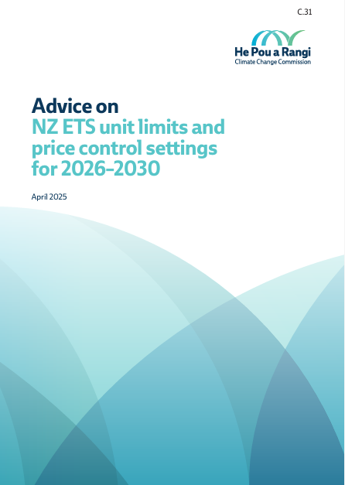
Our focus for this webinar
This NZ ETS settings advice
Narrow scope, focused on aligning unit auction settings with NZ’s emissions targets.
About operating the NZ ETS as well as possible given its current structure and current Government policy.
Our other emissions reduction advice
Addresses bigger picture climate policy issues – e.g., the level of targets, how to achieve them, and NZ ETS overall role and structure.
Monitors progress.

Slide 4
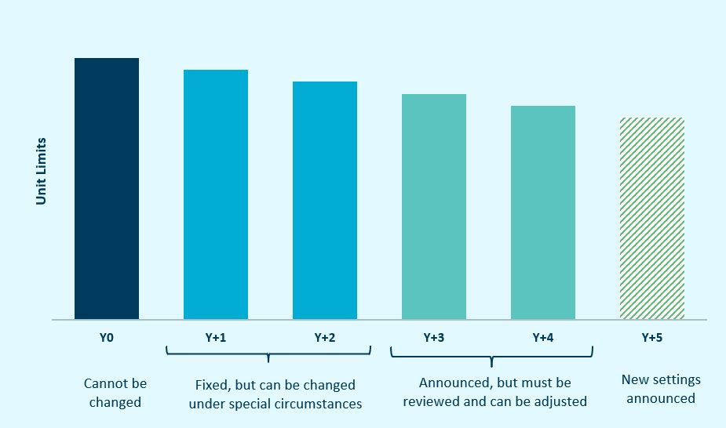
Context: Approach to managing NZ ETS settings
The five-year rolling process for unit limits and price control settings
The NZ ETS settings must accord with the 2050 target, emissions budgets, and NDCs.
Annual review of NZ ETS settings allows adaptive management.

Slide 5
Context: Wider issues
Achieving the first nationally determined contribution (NDC1)
In addition to domestic reductions, the Government needs to acquire offshore mitigation – this is still viable, but time is running short.
Further evolution is needed for a credible, predictable NZ ETS
If the scheme remains unchanged, its continued ability to contribute effectively to achieving targets in the 2030s will be called into question.

Slide 6
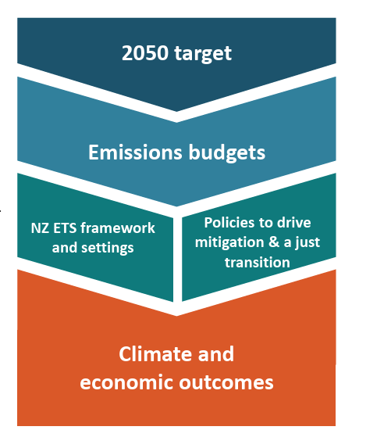
Context: Framework in the Climate Change Response Act (2002)
NZ ETS is a tool that acts as a messenger between emissions reduction targets and the economy.
Emissions budgets are the key targets guiding domestic reduction efforts.
In late 2024 we recommended a fourth emissions budget, reducing budgets 1–3, and strengthening the 2050 target. The Government’s decision is due by the end of this year.
For now, current emissions budgets and 2050 target remain the domestic targets guiding the NZ ETS settings advice.
Source: Initial Briefing to the Environment Committee, Climate Change Response (Zero Carbon) Amendment Bill

Slide 7
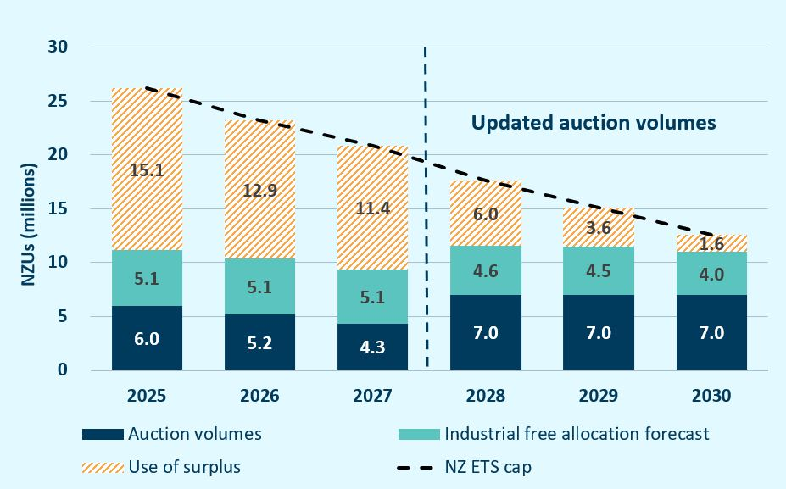
Unit limits (1): Our advice
We recommend no change to the unit limits for 2026 and 2027.
Emissions cap volume can be re-allocated to auctions, while remaining aligned with emissions reduction targets.
Auction volumes to be offered in the years 2028, 2029 and 2030, subject to adequate price guardrails.
No change
Updated volumes

Slide 8
Unit limits (2): The Government’s second emissions reduction plan
Second emissions budget volume | 305.0
ERP2 projected emissions 2026-2030 (Mt CO₂e)
Gross emissions | 363.4
Net emissions | 303.1
Non-NZ ETS allocation
Net emissions outside NZ ETS | 211.8
NZ ETS allocation (NZ ETS emissions cap)
Net emissions inside NZ ETS | 91.3
In December 2024, the Government released its second emissions reduction plan (2026–2030), which made clear:
The NZ ETS is the main tool the Government will use to reduce emissions.
The emissions cap the Government expects to implement into the NZ ETS.
Our advice takes this into account, as NZ ETS settings need to be compatible with the Government’s emissions reduction plan.
Source: Technical Annex to the second emissions reduction plan 2026–2030

Slide 9
Unit limits (3): the established 7-step method
Step | New information | Result
1. Align with targets | Second NDC and Biennial transparency report | Approach unchanged
2. Set emissions cap | Govt ERP2 decision on provisional NZ ETS cap | Lowered cap in line with ERP2 decision
3. Technical adjustments | Technical discrepancies largely resolved | Technical adjustments removed
4. Industrial allocation | New allocative baselines Changes to production | Forecast industrial allocation reduced
5. Address surplus units | Updated unit stockpile data Updated forestry allocation data EY report on surplus methodology | Incorporated new data and updated several aspects of our methodology. Surplus estimate is lower than forecast in 2024
6. Set overseas unit limit | N/A (no overseas units have been approved) | Approach unchanged. Limit set at zero
7. Calculate auction volume & assess risks | Auctions have declined or partially cleared | Backloaded auction volumes to 2028–2030, with even spread over those years

Slide 10
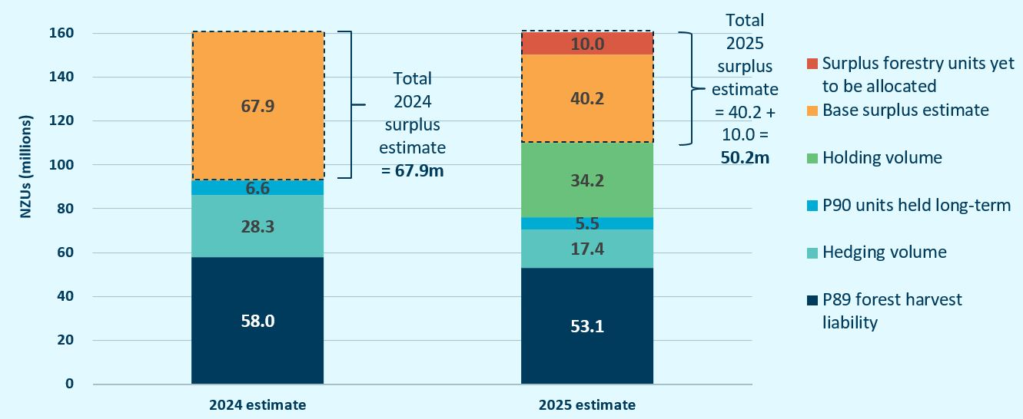
Unit limits (4): Surplus volume is lower than previous forecasts

Slide 11
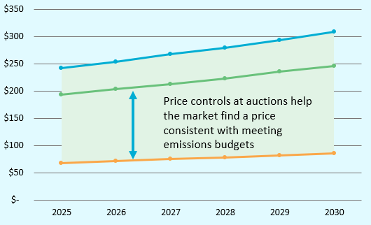
Price controls (1): Fit-for-purpose with inflation adjustments
The ARP and CCR trigger prices should remain at current levels, adjusted only for inflation.
The current settings are consistent with the Government’s emissions reduction targets.
We see no case for reducing the ARP, either now or in future.

Slide 12
Price controls (2): ERP2 means reassessment needed
This year, we needed to re-analyse the price control settings in light of ERP2, as it represents a different strategy compared to ERP1.
The Government’s ERP2 modelling puts the country:
on track to meet the second emissions budget
off-track for the third budget/second NDC by ~9 Mt.
The key challenge for us was assessing what emissions price range would be consistent with meeting the third emissions budget and second NDC.

Slide 13
Price controls (3): Consistency with the second emissions budget
The current price control settings are consistent with the second emissions budget:
By 2026, it will be too late for planting forests to help meet the second budget – so cost of gross emissions reductions is the key factor to guide the settings.
This price range is also appropriate taking into account international emissions prices, including the possible costs of offshore mitigation to meet the first NDC.
Stability in the price control settings, particularly the ARP, is important for market confidence.

Slide 14
Price controls (4): Consistency with third budget and NDC2
On these targets for 2031–2035, our analysis found that:
In some scenarios of the future, the price control settings could be too low to be consistent with meeting the third budget and second NDC.
But it’s not clear that those scenarios will materialise – there are large uncertainties about what actions will be needed to meet these targets.
We are not recommending an increase to the price control settings now, when it is so uncertain that it is necessary.
Some uncertainty will resolve over the next 2–3 years. We will monitor relevant developments in our future advice.

Slide 15
What happens next
Mid-2025
MfE to consult on NZ ETS settings.
30 September 2025
Government must finalise NZ ETS settings regulations for 2026–2030.
31 December 2025
Government must decide on fourth emissions budget, revisions to existing emissions budgets and to 2050 target.
Early 2026
Next NZ ETS settings advice, for 2027–2031.

Slide 16
Ngā mihi nui Thank you
Want to get in touch? hello@climatecommission.govt.nz

